Slide 1
CSE 2233 Theory of Computing
Shekh. Md. Saifur Rahman
Lecturer, CSE Department
UIU

Slide 2
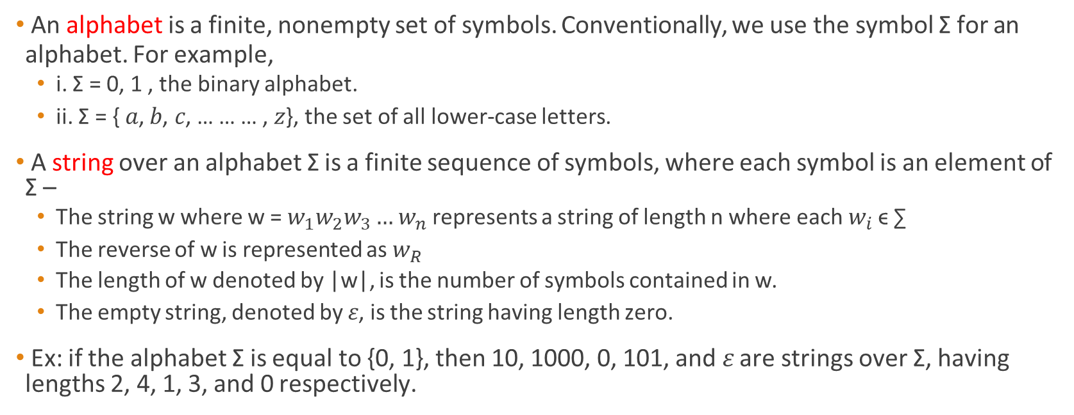
Terminology - Strings
An alphabet is a finite, nonempty set of symbols. Conventionally, we use the symbol Σ for an
alphabet. For example,
i. Σ = 0, 1 , the binary alphabet.
ii. Σ = { 𝑎, 𝑏, 𝑐, … … … , 𝑧}, the set of all lower-case letters.
A string over an alphabet Σ is a finite sequence of symbols, where each symbol is an element of Σ –
The string w where w = $w_{1}w_{2}w_{3}…$ $w_{n}$represents a string of length n where each $w_{i}$ ϵ ∑
The reverse of w is represented as $w_{R}$
The length of w denoted by |w|, is the number of symbols contained in w.
The empty string, denoted by 𝜀, is the string having length zero.
Ex: if the alphabet Σ is equal to {0, 1}, then 10, 1000, 0, 101, and 𝜀 are strings over Σ, having lengths 2, 4, 1, 3, and 0 respectively.
Lecturer Saifur Rahman, Dept. of CSE, United International University

Slide 3
Continued…
Power of an Alphabet:
Σ¹ -> Length is 1
Σ^{k} = set of string of length k, where each and every symbol of the strings belongs to Σ. Σ = {0, 1}
Σ¹ = {0, 1}
Σ² = {00, 01, 10, 11}
Σ³ = {000, 001, 011, 100, 101, 010, 110, 111} Σ⁰ = {𝜀}
Lecturer Saifur Rahman, Dept. of CSE, United International University

Slide 4
Continued…
Σ⁰, Σ¹, Σ², …., Σ^{k}
Σ⁺ = Σ¹ U Σ² U Σ³ …. Σ* = {𝜀} U Σ⁺
Language:
Σ = {a, b}
L = {any string that starts with a}
= {a, aa, ab, aaa, a, ….}
L = {any strings that starts with a and it’s length is 2}
= {aa, ab}
Lecturer Saifur Rahman, Dept. of CSE, United International University

Slide 5
Terminology - Language
Language: A set of strings all of which are chosen from some Σ∗ , where Σ is a particular
alphabet, is called a language.
Regular Language: These languages are exactly the ones that can be described/recognized by Finite Automata. This language can be processed by computers having a very small amount of memory.
Here,
- Computer is meant by a computational model that varies depending on the feature we want to focus on.
Lecturer Saifur Rahman, Dept. of CSE, United International University

Slide 6
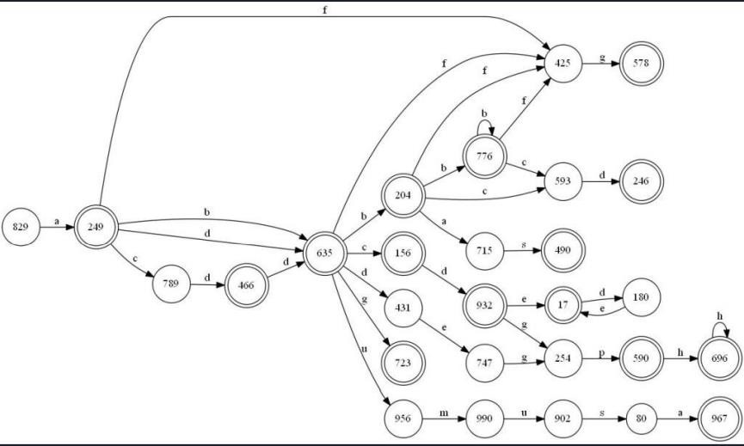
Finite Automata
Lecturer Saifur Rahman, Dept. of CSE, United International University

Slide 7

Finite Automata
Finite automata are good models for computers with an extremely limited amount of memory.
What can a computer do with such a small memory?
Lecturer Saifur Rahman, Dept. of CSE, United International University

Slide 8
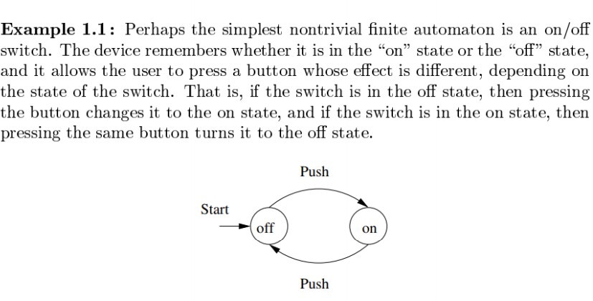
On-off switch Finite Automaton?
Lecturer Saifur Rahman, Dept. of CSE, United International University

Slide 9
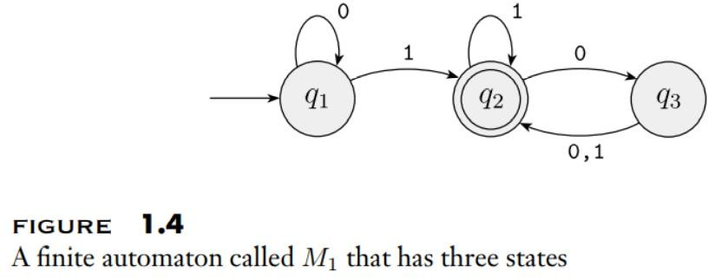
Heading towards the definition
Lecturer Saifur Rahman, Dept. of CSE, United International University

Slide 10
Finite Automata – Still not formal definition
Finite Automata: A finite automaton (FA) is a simple idealized machine used to recognize patterns within input taken from some character set (or alphabet) ∑ . The job of an FA is to accept or reject an input depending on whether the pattern defined by the FA occurs in the input.
Graphical Representation:
Node (for states)
Arcs (for transitions)
Lecturer Saifur Rahman, Dept. of CSE, United International University

Slide 11
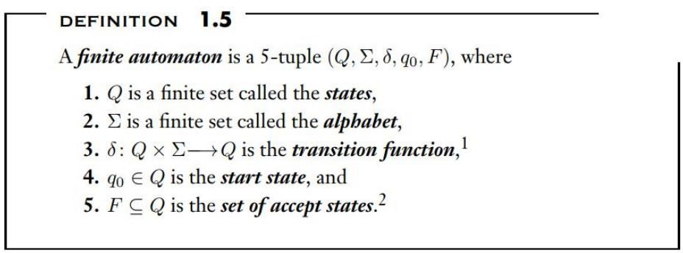
Formal definition of Finite Automaton – Finally.
Lecturer Saifur Rahman, Dept. of CSE, United International University

Slide 12
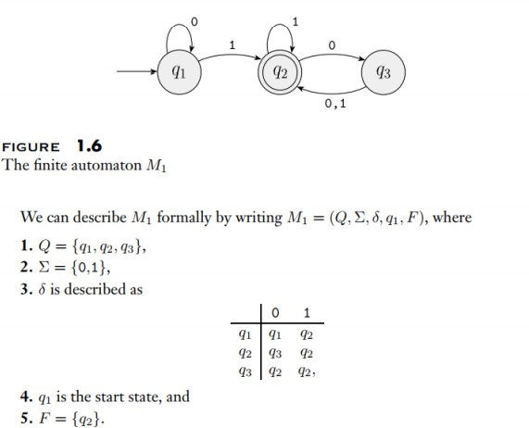
Example
Lecturer Saifur Rahman, Dept. of CSE, United International University

Slide 13
FA – Machine M
If A is the set of all strings that machine M accepts
We say that A is the language of machine M
We write L(M) = A.
We say that M recognizes A or that M accepts A.
Lecturer Saifur Rahman, Dept. of CSE, United International University

Slide 14
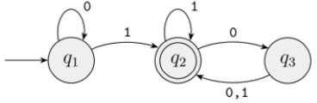
FA- Machine M
A machine may accept several strings, but it always
recognizes only one language.
If the machine accepts no strings, it still recognizes one language - the empty language ∅.
For this example, we say if L(M) = A , then
A = {w| w contains at least one 1 and an even number of 0s follow the last 1}
Lecturer Saifur Rahman, Dept. of CSE, United International University

Slide 15
Deterministic Finite Automaton (DFA)
The term “deterministic finite automata” refers to the fact that on each input there is one and
only one state to which the automaton can transition from its current state.
Lecturer Saifur Rahman, Dept. of CSE, United International University

Slide 16
Example:
Σ = { a, b}
L : set of string of length 2
{aa, ab, ba, bb}
a, b
a, b
a, b
a, b
q₀
q₁
q₂
q₃
Lecturer Saifur Rahman, Dept. of CSE, United International University

Slide 17
Example:
Σ = { 0, 1}
L : {a set of string that has 101 as substring}
{101, 0101, ….}
0
1
1, 0
q₀
1
0
q₂
1
q₁
q₃
0
Lecturer Saifur Rahman, Dept. of CSE, United International University

Slide 18
Continued…
Q = {q_{0,} q_{1,} q_{2,} q₃}
Σ = {0, 1}
𝛿 is described as
 | 0 | 1
q₀ | q₀ | q₁
q₁ | q₂ | q₁
q₂ | q₀ | q₃
q₃ | q₃ | q₃
Lecturer Saifur Rahman, Dept. of CSE, United International University

Slide 19
Example:
Design a FA with ∑ = {0, 1} accepts those string which starts with 1 and ends with 0.
Design a FA with ∑ = {0, 1} accepts the only input 101.
Design FA with ∑ = {0, 1} accepts the set of all strings with three consecutive 0’s.
Design a FA with ∑ = {0, 1} accepts the strings with an even number of 0's followed by single 1.
Design FA with ∑ = {0, 1} accepts even number of 0's and even number of 1's.
Lecturer Saifur Rahman, Dept. of CSE, United International University

Slide 20
Thank You

